Slide 1

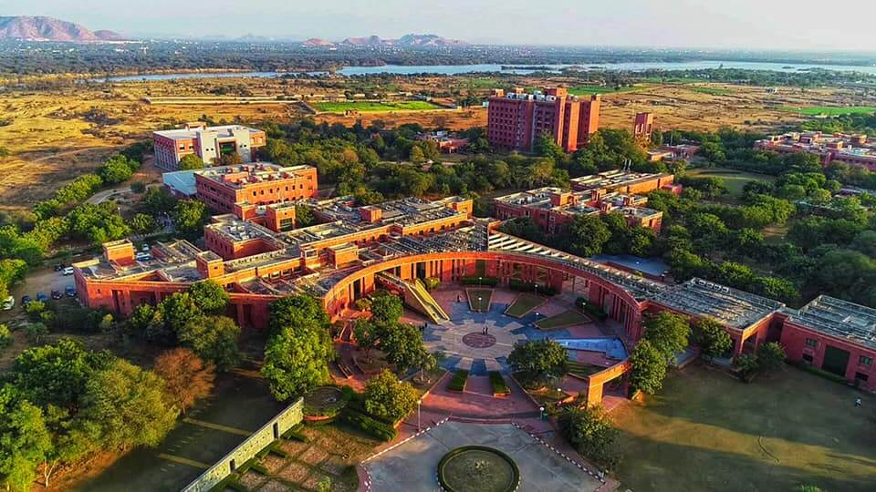
SPORTS INVENTORY MANAGEMENT SYSTEM Team Members:- Abhinav Midha(21UCS003) Ananya Khadria(21UCS019) CHANDANDEEP SINGH(21UCS049) DHRUV BANDI(21UCS065) DIVYANSHI AGARWAL (21UCS074)

Slide 2
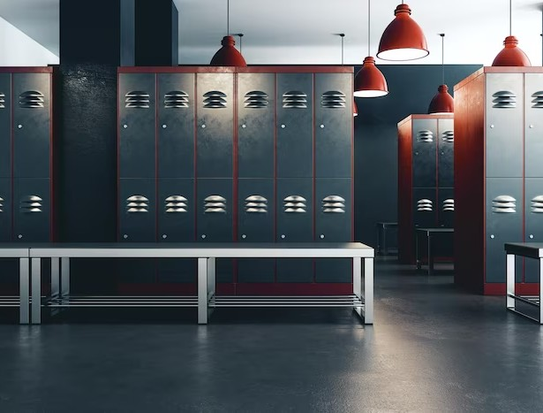

INTRODUCTION
Introducing our Sports Inventory Management System(SIMS), a cutting-edge solution that provides real-time access to campus sports equipment and inventory, ensuring efficient management and accessibility for all sports enthusiasts.

Slide 3
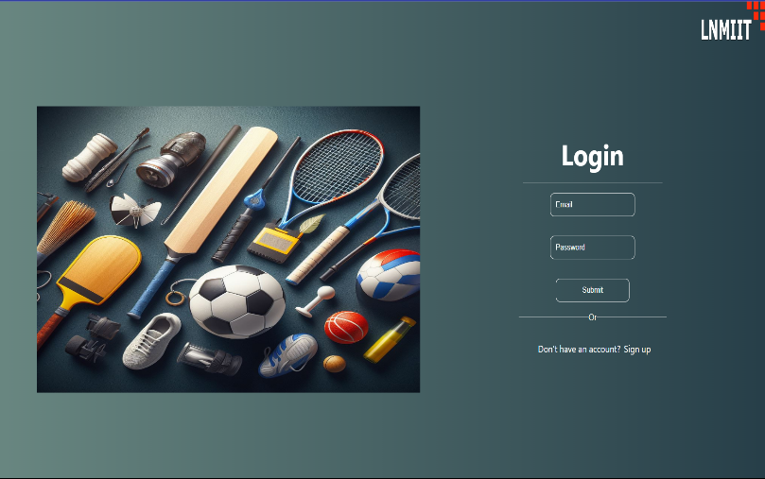
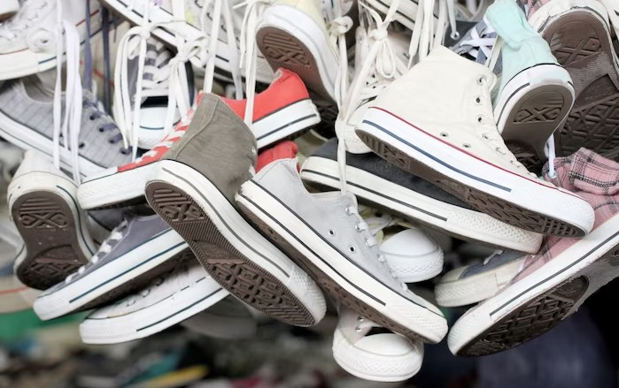
Functionality
User can see the inventory in real time of what is available for specific sports in our college
Secure user login and authentication is core part of our SIMS Website

Slide 4
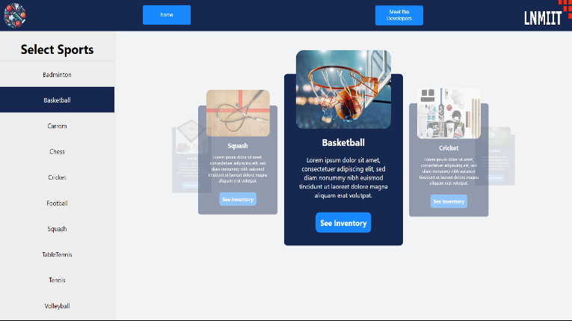
HOME PAGE
Key Components
Navbar : provides quick access to key sections and user-related functions, enhancing the user experience
Sidebar : vertical panel offering secondary navigation.
Carousel : 3d user interactive card slider for user to see the inventory of any sport

Slide 5

Version 2.O
Reserve Button Functionality :
Implementation of a "Reserve" button that allows users to request and reserve specific sports equipment or facilities.
User Dashboard :
Introduction of a user dashboard where individuals can view their borrowing history, including past reservations, equipment borrowed, and return dates.

Slide 6

Thank You for your time!

